Slide 1
Stock trade, analysis and portfolio management system
Stock trade, analyst simulator and portfolio management
For Windows desktop application
Developed by Quan Xing, Guofeng Wu

Slide 2
Background
The purpose is to provide to investor a tool for analysing the history of a stock price, make an informed decision of stock trade, and management his investment portfolio.

Slide 3
Overview:
Analyst Chart
Paper trading
Portfolio management
Watch list

Slide 4
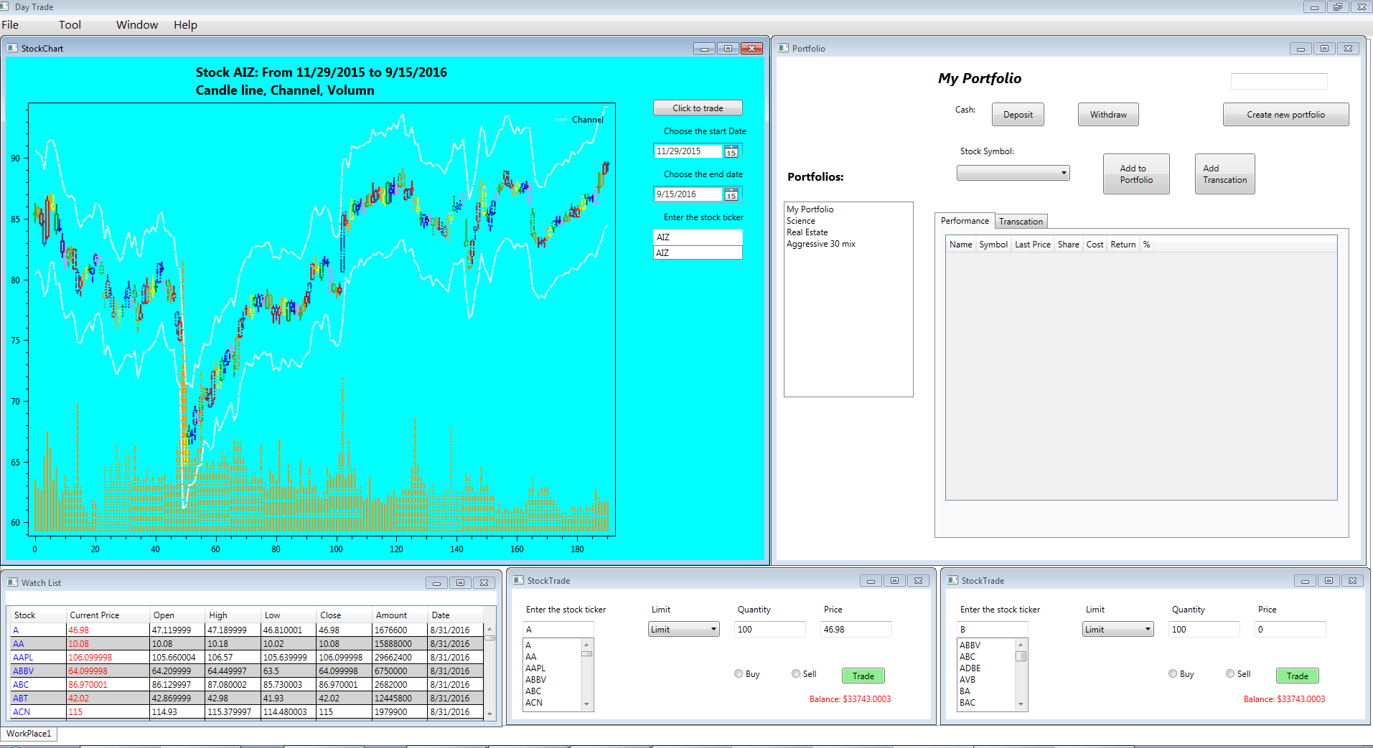
GUI:

Slide 5
Problem 1:
Install new library, try DynamicDataDisplay, Visifire, WPF Toolkit, Xceed Toolkit Plus.
Set the oxyPlot library which is 2D plot open code generation library

Slide 6
Problem 2:
candle line, no rectangle in library
( oxyPlot: 2D plot generation library )
draw by myself with price calculation

Slide 7
Problem 3:
check quantity and cost by stock ticker
write the right query without extra data.
Set action buy=1, sell=-1 , none = 0

Slide 8
Problem: Get history data for stock and import to Azure database
SP500 company as sample
Daily data using webClient.DownloadFile(url, dayFile)
from yahoo financehttp://ichart.finance.yahoo.com
Combine the 500 separate file into one file to fit the table structure
Using import tool of MS Sql Server to Azure database
Local import, script export, run script on Azure
Direct

Slide 9


Problem: Show the processed data from database in datagrid
Create a separate class and binding it to datagrid object
Problem: Read and Insert a non nullable data into database

Slide 10
Screen shot

Slide 11
Screen shot

Slide 12
Screen shot

Slide 13
Screen shot

Slide 14
Future work
Live data
Trend Lines on Chart
Print
Layout design
Account
Position
Risk analyst
Delete portfolio and edit portfolio transaction data

Slide 15
Summary
Show candle like stock history chart (daily chart)
Make paper trade
Do investment portfolio management

